Slide 1

ML Assignment -2
Team members:
Kesava Datta
Sam Dheeraj
Lakshmi Shivani
Kritika Reddy

Slide 2
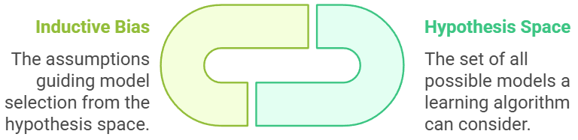
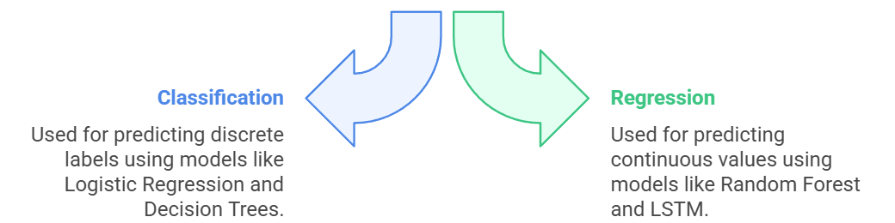
Task 1
Problem Statement:
Now a days, Co2 emission is increasing rapidly due to increase of population. For the predicting the Co2 emission using machine learning models of different types of vehicles.
Input Features:
Engine Size: 2.0L
Cylinders: 4
Vehicle Class: Compact
Random Forest Prediction:
100 trees predict CO2 emissions:
Tree 1: 180 g/km
Tree 2: 190 g/km
Tree 3: 185 g/km
...
Tree 100: 195 g/km
Reference:
Kumari, S., & Singh, S. K. (2023). Machine learning-based time series models for effective CO2 emission prediction in India. Environmental Science and Pollution Research, 30(55), 116601-116616.
Baxter, J. (2000). A model of inductive bias learning. Journal of artificial intelligence research, 12, 149-198.
Loh, W. Y. (2011). Classification and regression trees. Wiley interdisciplinary reviews: data mining and knowledge discovery, 1(1), 14-23.
Final Prediction:
Average of all predictions:188g/km
Predicted CO2 emissions: 188 g/km

Slide 3
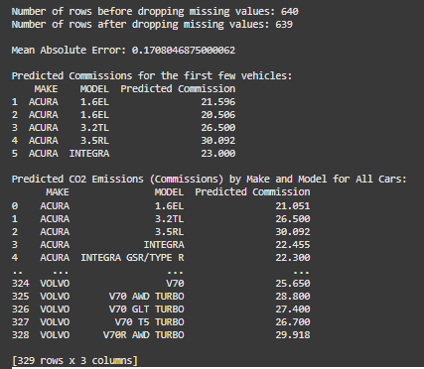
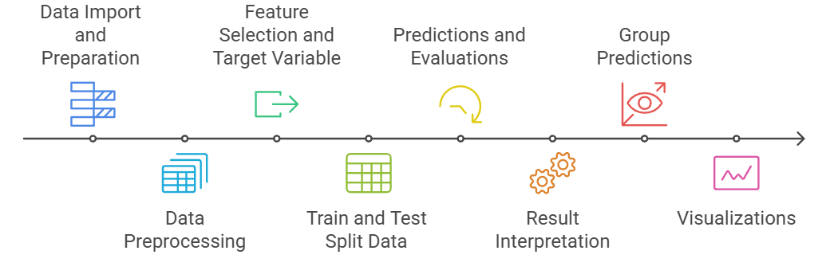
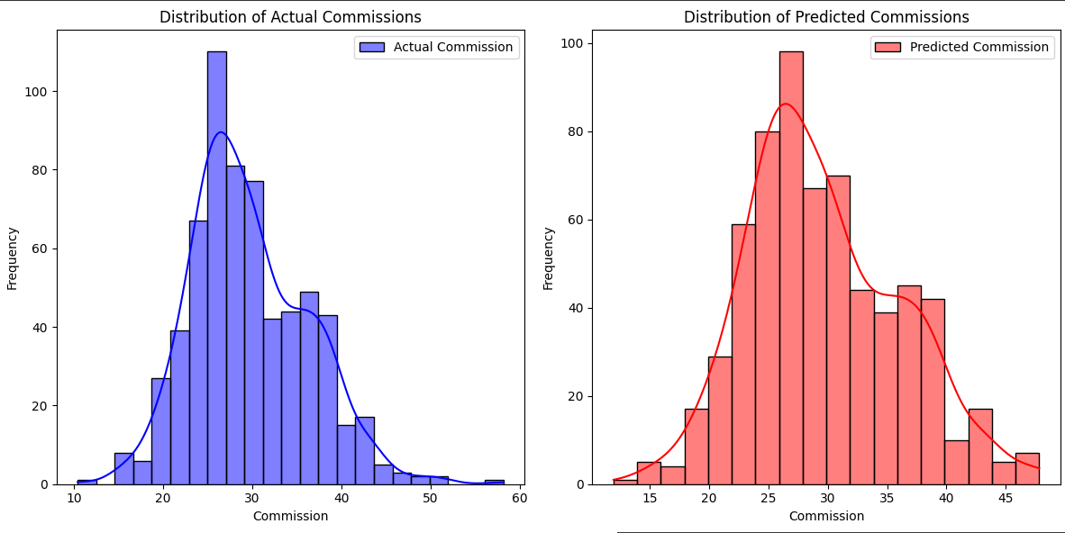
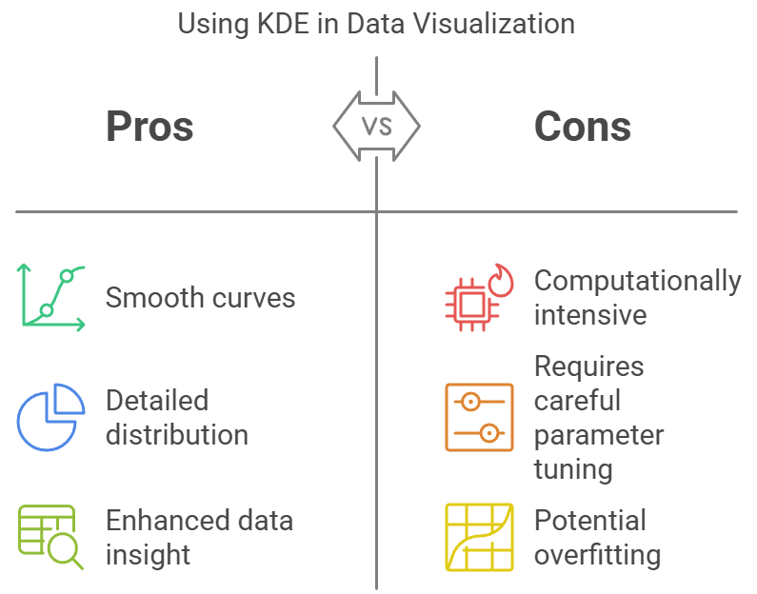
Task 2

Slide 4
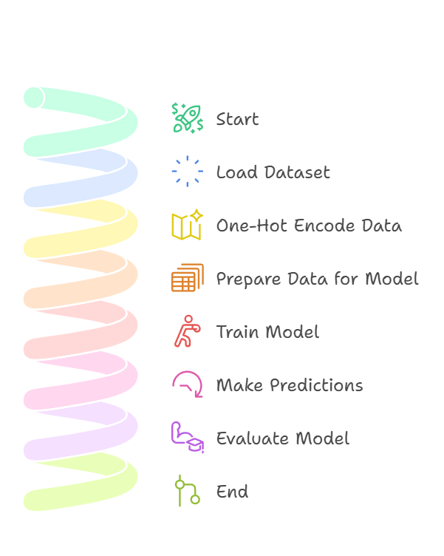

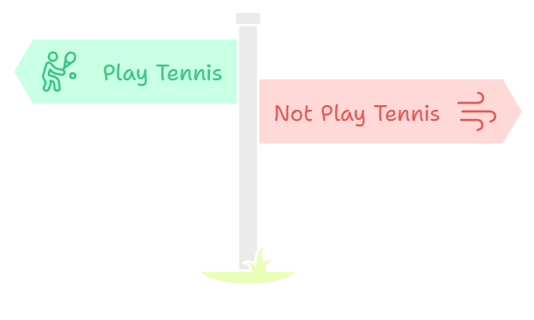
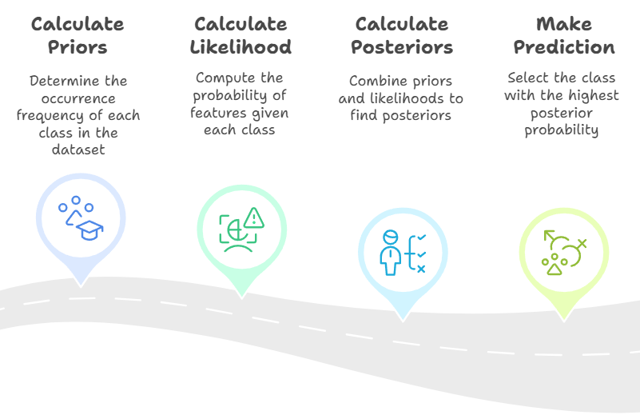
Result:
Task 3

Slide 5
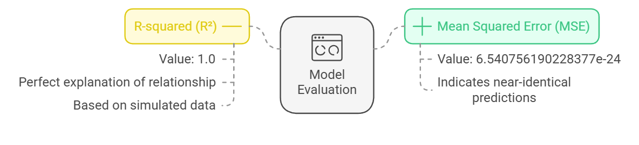
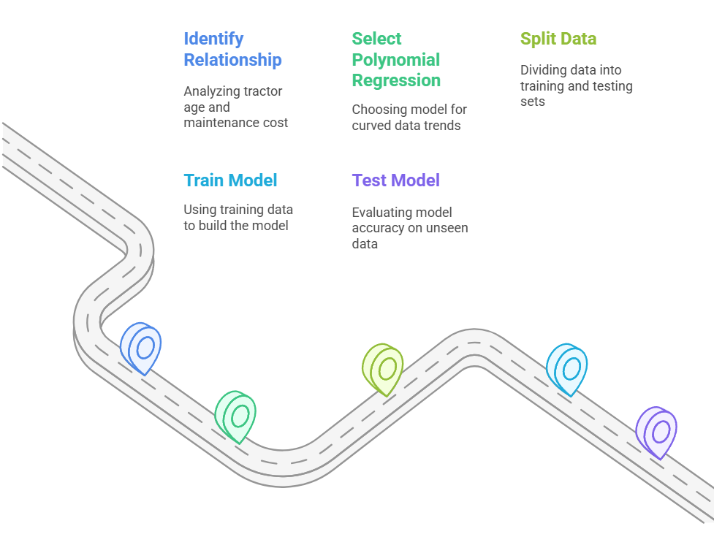
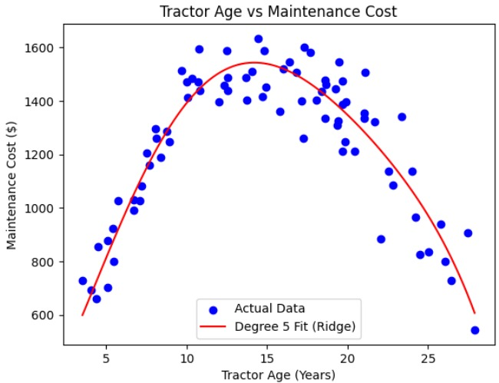
Task 4

Slide 6

This Photo by Unknown Author is licensed under CC BY-SA

